Slide 1

RPS x
Rock paper scissor X-TREME
By: Group 6

Slide 2

Team Members & Roles
Ikenna Acholonu – Project Manager
Christopher Rodbourne - Front End Developer
Suvrat Jain - Mobile App
Daniel Schiff - Mobile App/Chart
Tyler Cuervo – API/Database
Greg Eugene - Front End Developer
Alexander Meade - API/Database

Slide 3
About
RPS X-treme is the next evolution of your favorite juvenile game - now you can settle your petty disputes from your handheld device, or set up tournaments to determine the alpha member of your entire friend group. To be exact, RPS X-treme is an Android app that makes it possible to set up/join lobbies for rock-paper-scissors matches and also keeps track of a variety of player performance statistics. Players will be able to log in and make or join a lobby.

Slide 4
Gantt chart

Slide 5
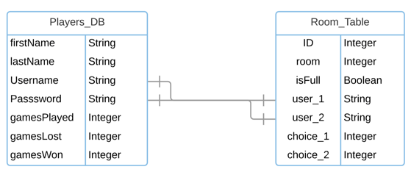
Use case and er diagram

Slide 6
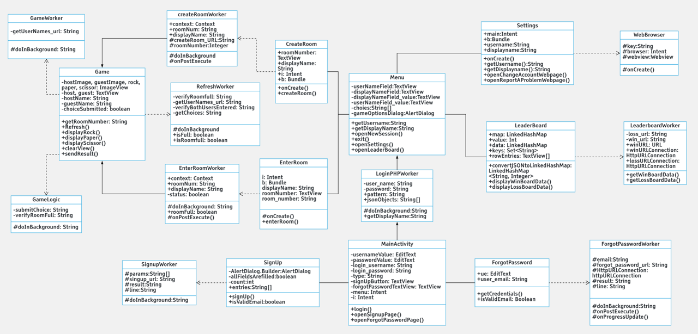
Class diagram

Slide 7
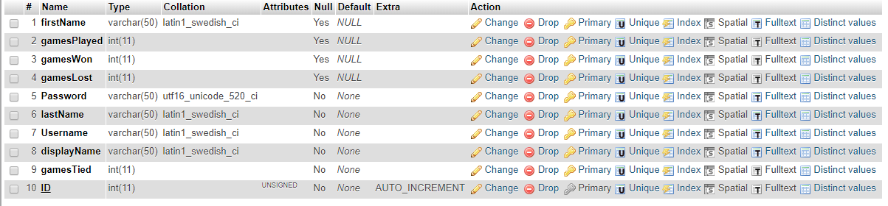
Database

Slide 8
Concept

Slide 9
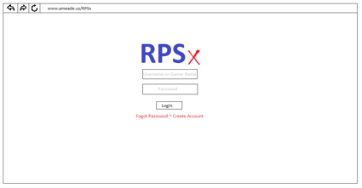
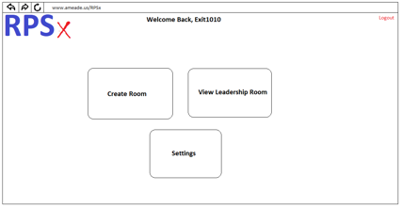
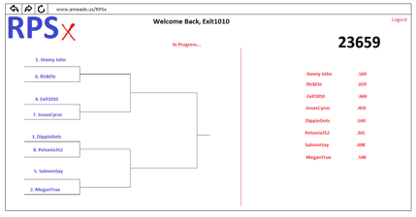
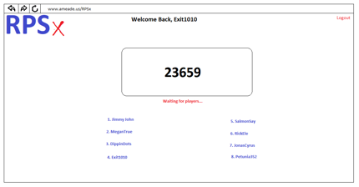

Slide 10
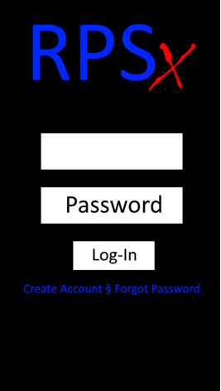
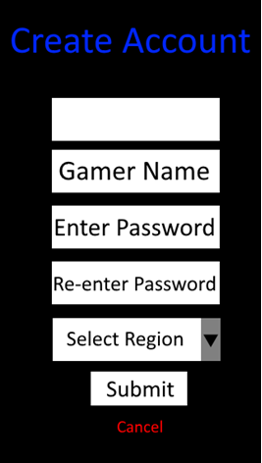
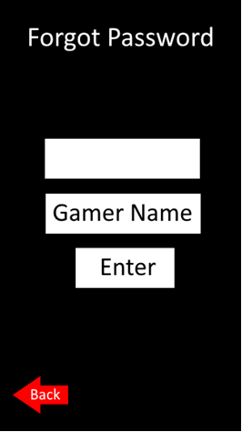
Username
Username
Username

Slide 11
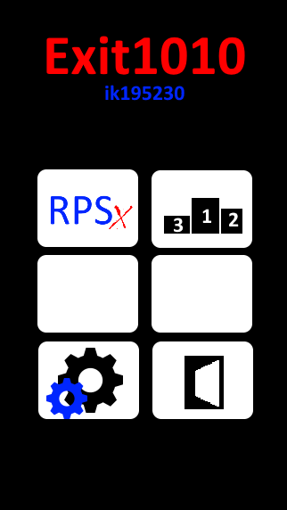
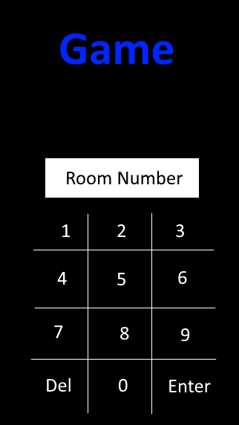
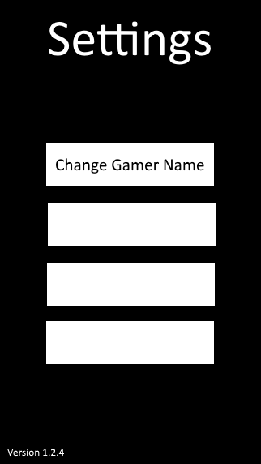
Change Password
Sound Settings
Report a Problem

Slide 12
Final Version

Slide 13
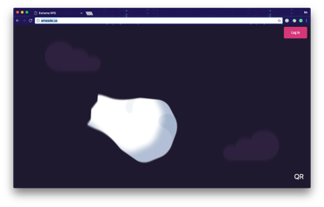
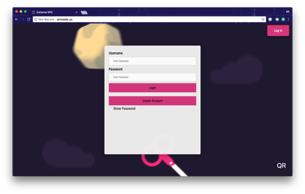
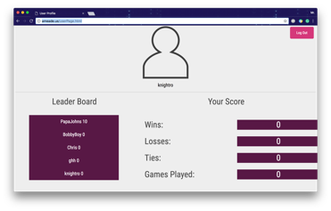
Webpage

Slide 14
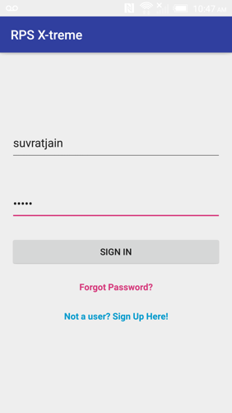
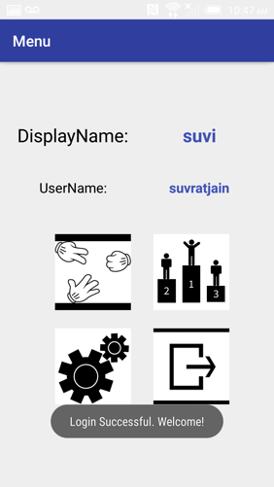
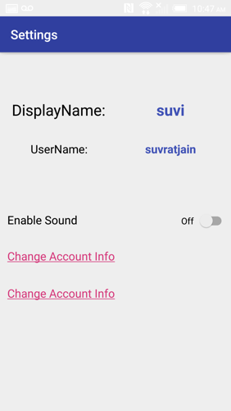
Mobile App

Slide 15
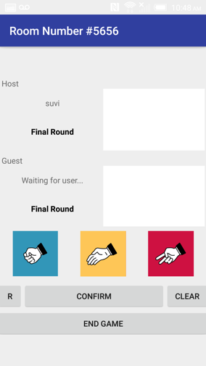
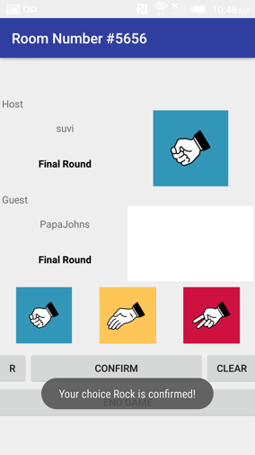
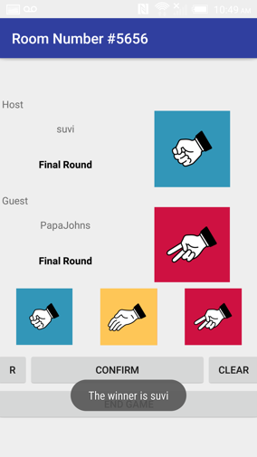
Mobile app

Slide 16
Features to be added soon
Region tournament style
rps store
play via Bluetooth
timer
Lighting round

Slide 17
Issues encountered
Time management
Getting all of us together
Using older versions from github/source tree
Not allocating many people to the app initially

Slide 18
DEMO
http://www.ameade.us/

Slide 19


Slide 20
References
http://www.ameade.us/
https://www.dropbox.com/s/0u4byfej0yqlz4b/app-release.apk?dl=0

Slide 21
Questions?

